Slide 1

HARNESSING INTERNATIONAL LAW TO FORESTALL AN ARMS RACE IN OUTER SPACE
Kiran Krishnan NAIR

Slide 2
BROAD STRUCTURE
ARMS RACE IN SPACE
Genesis.
The Doctrine.
The Present Status.
The likely future.
THE LEGAL CONTEXT
International Law.
PAROS to PICOS
International Institutions (the United Nations).
THE OPERATIONAL CONTEXT
WMC TO WMD in Space.
Common Areas of International Cooperation in Space.
Common Areas of Collective Defence in Space.
Recommendations.

Slide 3
Space Security & Development
Space Capabilities critical for National Development & day-to-day life.
Present Concept of Development all-encompassing
(Civil Development & National Security)
Concept of Security not confined to conflict amongst states.
Space critical lynchpin of all military modernisation & security in its comprehensiveness.
Space = Valentine + Budget Spirit (Exquisite & Fragile/ Valuable & Vulnerable).

Slide 4



CONTEXTUALISING SPACE
Notes:
It’s Valentine’s & most of us feel the pinch of the budget.

Slide 5
Satellite | Number of Satellites-Year wise |  |  |  |  |  |  |  |  |  | First Soviet launch date.
 | 1958 |  | 1959 |  | 1960 |  | 1961 |  | Total
 | US | USSR | US | USSR | US | USSR | US | USSR | US | USSR
Comm | 01 | 00 | 00 | 00 | 02 | 00 | 00 | 00 | 03 | 00 | 1964
Nav | 00 | 00 | 01 | 00 | 01 | 00 | 03 | 00 | 05 | 00 | 1967
Photo-Reccee | 00 | 00 | 06 | 00 | 06 | 00 | 13 | 01 | 25 | 01 | 1962
Early Warning | 00 | 00 | 00 | 00 | 02 | 00 | 03 | 00 | 05 | 00 | 1971
Met | 00 | 00 | 00 | 00 | 02 | 00 | 01 | 00 | 03 | 00 | 1963
Within first few years, most space missions of ordnance delivery (BM/FA), mil sats for FE, & battles for control of space (asats) already in place.
Vide project Argus (1958), us detonated ‘N’ devices in space. By 1962 soviets also detonated ‘N’ devices.
Thus, OUTER SPACE TREATY built upon prevailing status quo in space & hence Peaceful uses = Military use of sats, BMs transiting, (subject to certain restrictive legislative clauses).
Law prohibits ‘N’ & WMD in space.
Notes:
Fundamentally, in law the better the factual position the better the result & hence essential to accept bitter truths.

Slide 6


DOCTRINAL UNDERPINNINGS
US PERCEPTIONS ON SPACE UTILITY
Role | Airpower Mission | Perceived Space Mission
Control of Environment | Control of Air Counter Air Ops | Control of Space Counter Space
Applying Combat Power | Air - Force Application (Strike/CSFO) | Space – Force Application
Enhancing Combat Power | Airborne Combat Support/ Force Enhancement | Space Based Force Enhancement
Sustaining Combat Forces | Air Support Operations (Logistics, PAD) | Space Support (Launch, orbit support etc.)
FSU PERCEPTIONS ON SPACE UTILITY
ROLE | SPACE MISSIONS (SOKOLOVSKY DOCTRINE)
1 | CREATION OF SPACE SYSTEMS FOR COMBAT EFFECTIVENESS OF ARMED FORCES = FORCE ENHANCEMENT
2 | PREVENTING OTHER COUNTRIES FROM USING SPACE = COUNTER SPACE
3 | DEVELOP STRATEGIC OFFENSIVE SYSTEMS
4 | ???

Slide 7
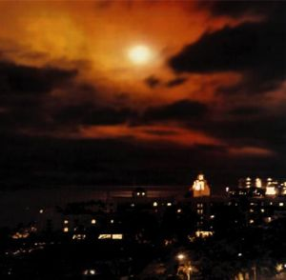
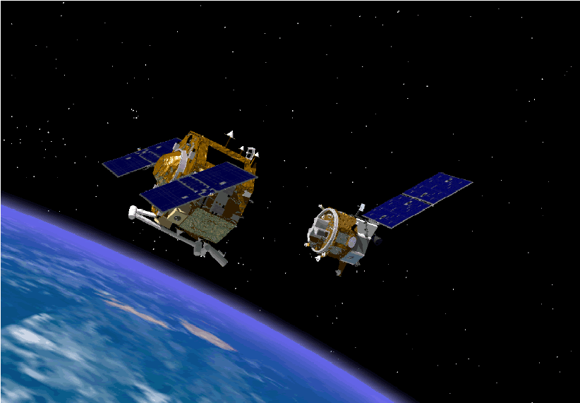
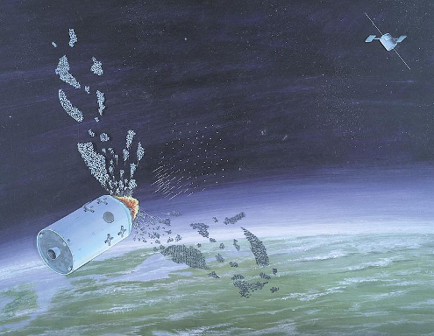
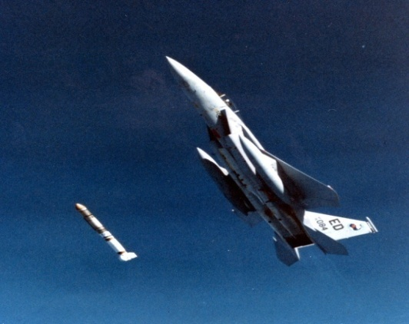
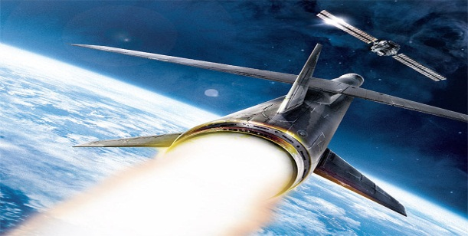
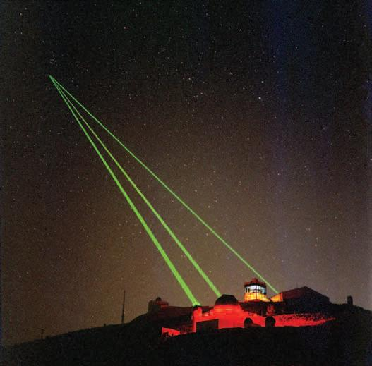
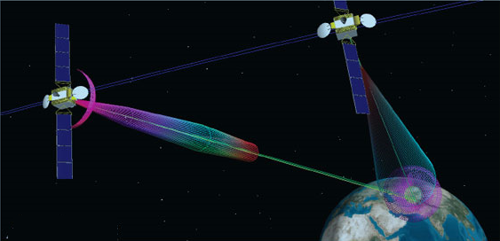
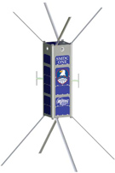
Major Types of Space Weapons
NUCLEAR BLAST: US & RUSSIA (1960-70)
CO-ORBITAL ASATS TESTED BY RUS IN 1970
PELLET ASATs (1970-80)
Air Launched US (1985)
KINETIC ASAT: CHINA (2007) & US (2008)
LASERS DAZZLING, DISABLING (2010,2011,2012)
NETWORK INTERFERENCE AND JAMMING
MICRO/NANO SATS IN ASAT ROLES

Slide 8
THE PRESENT STATUS
Only 3/195 nations on Earth see any sense in space weapons.

Slide 9
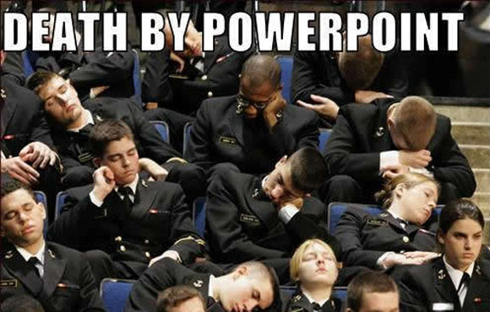

Slide 10
GEO-ECONOMICS OF SPACE-1
Space economy on upswing despite global recession.

Slide 11
GEO-ECONOMICS OF SPACE-2
Leading Space faring nations are lead investors-returns are high.

Slide 12
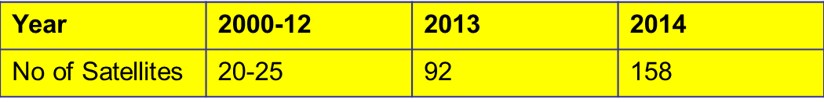
THE CHANGE (Future Shock)
Space democratised: Unlike CW era, Dec 2014, 1261 operational satellites operated by 57 countries.
Trend towards dual use rather than dedicated military satellites, 12 in 2014, 08 in 2015.
Cheaper: Affordable Micro and Nano satellites, increased redundancy, targeting complexities.
Incentives to destroy satellites has reduced, serves little operational purpose.

Slide 13
WHAT IS UNCHANGED
The aspiration to use space across the world.
→ Developing & developed nations.
The law related to space & impasse
→ Peaceful use: Dual use satellites.
→ Competition in space.
→ Need for sustained use & access to space.
International law on the peaceful use of outer space.
DOES IT MAKE SENSE TO JOIN THE RAT RACE OF AN ARMS RACE IN SPACE ???
Notes:
PSLV has 100% reliability and costs 30 Million only.

Slide 14

International Law
Sources of International Law (Art-38)
Treaties
Customary Int Law
General Principles of Int Law
Judicial Decisions & Writings
In addition to above, non-binding ‘soft-law’ instruments like the Space Code of Conduct have also been proposed

Slide 15
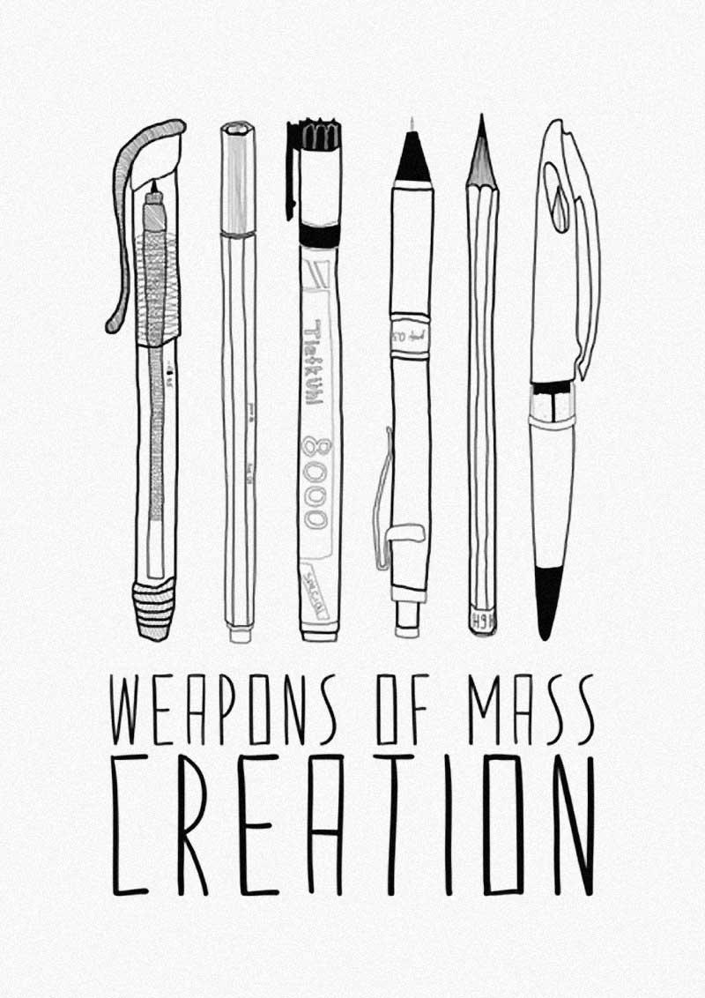
THE PRESENT STATUS
CREATIVITY
PPWT
ICOC
MILAMOS
No great movement on existing instruments and hence may consider focus on other areas also.

Slide 16
WMC TO WMD IN OUTER SPACE
Shift focus from words to action in space.
→ Use Space as Weapons of Mass Development.
Focus on International Law to promote and institutionalise Development & International Coop. → Focus on Affirmative Obligations rather than Negative Proscriptions.
→ Some issues in (-ve) proscriptions
• Vintage design of law
• Enforcement & Verification issues
• Definitional & semantic issues
Notes:
PSLV has 100% reliability and costs 30 Million only.

Slide 17
From PAROS to PICO with WMD
• PAROS: Contentious national security issues – deep individual sensitivities, no common ground- no consensus.
• PICO:
→ Areas of Common gain – consensus possible.
→ Areas of Common insecurity – consensus possible.
• Security is a subset of development & hence enhance security by PICO.
Notes:
PSLV has 100% reliability and costs 30 Million only.

Slide 18
International Law & PICO-1
• Outer Space Treaty-67: General & Specific obligations for International Cooperation
Language:
“State parties to contribute to broad International Cooperation...”,
“Desire to use space for International Cooperation”
“To develop mutual understanding & strengthen friendly relations amongst states...”
Notes:
PSLV has 100% reliability and costs 30 Million only.

Slide 19
International Law & PICO-2
• Samples of specific obligations
Art-1: “Expl & Use for benefit & interest of all countries...States shall facilitate & encourage Int Coop in scientific investigation”.
Art-3: “States shall carry on activities...promoting international cooperation & understanding”.
Art-9: “State parties shall be guided by principle of coop & mutual assistance....”
Art-10, 11 & 12 have similar language as also Art-2, 4 and 13 of the Moon Treaty.
Notes:
PSLV has 100% reliability and costs 30 Million only.

Slide 20
International Law & PICO-3
• Int Law & UN Charter made specifically applicable by Art-3
Broad precepts of Customary International Law also promote the concept.
Notes:
PSLV has 100% reliability and costs 30 Million only.

Slide 21
PROFLIGACY???
Sub optimal Use: Over 400 Earth Imaging sats do the same task.
→ Composite mosaic for agriculture makes more sense.
NAVSTAR, GLONASS, BEIDOU, GALILEO, QZSS, IRNSS.
→ 100 Navsats and yet unable to locate.
No system for sharing SATCOM capacity during disasters etc.
The ISS at over $ 150 Bn is the single largest contraption ever made.
Prudence demands International Cooperation. No need to sink money in the space Black Hole.
Notes:
PSLV has 100% reliability and costs 30 Million only.

Slide 22
Applicability of Space WMD-1
Conventional Areas:
→ Food security: Use EO imagery for agricultural development in Asia & Africa.
→ Health security: Connect the world on Telemedicine.
→ Education: Connect Universities on global Tele-education network.
→ Disaster relief
Velvet glove of diplomacy to convert concept to reality.
Connect the globe with space WMD
Notes:
PSLV has 100% reliability and costs 30 Million only.

Slide 23
Applicability of Space WMD-2
Un Conventional Areas:
→ Consolidate Global NAVSAT capacity to break crime-terror nexus.
→ Law (Art-1 & 3) demand int coop for interplanetary exploration. Time for dedicated international body.
→ Planetary exploration need not lead to competition & conflict. No Westphalia in OS. Global commons, global effort makes sense.
→ Asteroid defence & debris mitigation – common threat, common defence demand global effort.
Notes:
PSLV has 100% reliability and costs 30 Million only.

Slide 24
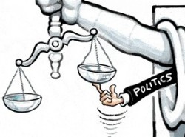
THE CHALLENGE
THE OPPORTUNITY
RECOMMEND USING THE INHERENT DYNAMISM OF INTERNATIONAL LAW TO ADAPT & INSTITUTIONALISE DEVELOPMENT & INTERNATIONAL COOPERATION

Slide 25
Thank You
For Allowing me to share my Ignorance!

Slide 26
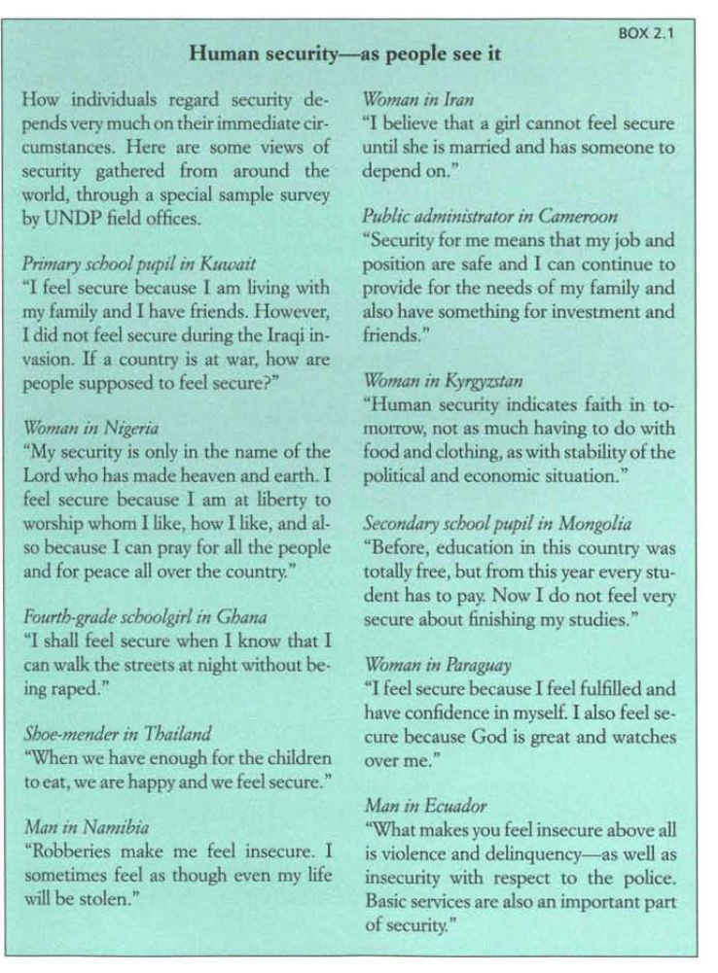

Slide 27
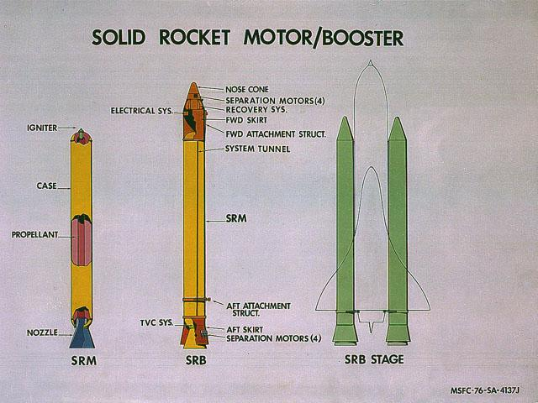
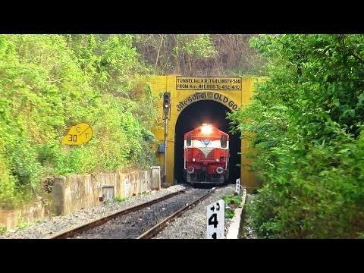
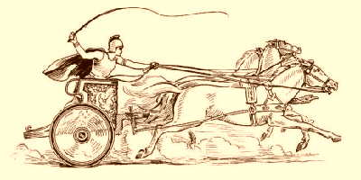
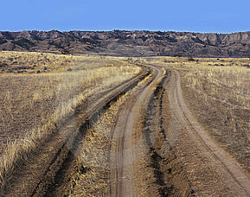
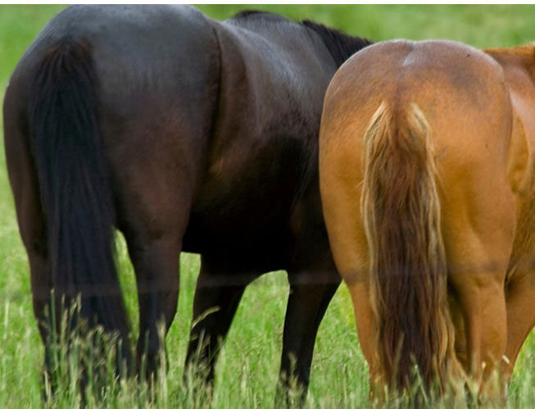
Linked by the 4’ 8.5 Inches rule

Slide 29
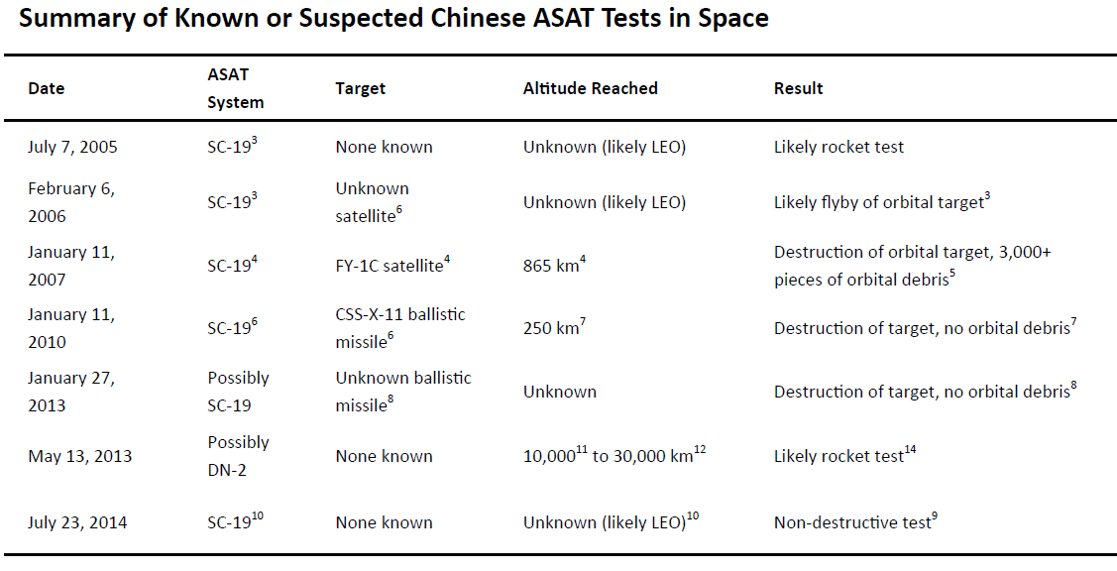
CHINESE CAPABILITIES HAVE EVOLVED BEYOND DEBRIS LITTERING KE-ASAT TESTs
Notes:
Chinese reacting to US, or US is, or Russia is; discourse settling down to another Post CW arms race in space with changed players.

